Slide 1
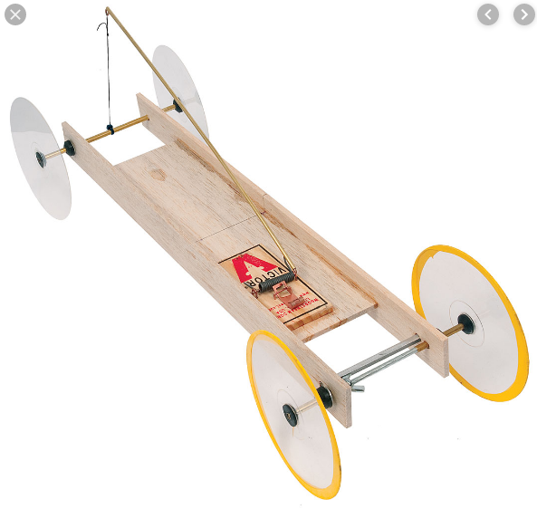
Mousetrap Car
Mid-Term Build Project

Slide 2
Sample Videos
Instructables Web Site
https://www.instructables.com/id/Mousetrap-Car-Explained/
Easy (3 min)
https://www.youtube.com/watch?v=J6xDXaPNfwU

Slide 3
Objectives
Today Nov 21 – Start Build
Form a Group 2-3 members
Plan your design (Show a sketch to Mr. Nestor)
Get materials & Start Build
Wed. Nov 27 – Complete Testing / Race Day
Testing Part 1: Initial Acceleration using motion sensor
Testing Part 2: Motion Video using Tape Measure
NOTE: Testing can be done Mon & Tues outside of class
Competition At End of the Period
Final Report (Due Date T.B.D.)
Report Details will be provided on Wed. Nov 27

Slide 4
Design Checklist
Watch Videos / Brainstorm Ideas With Your Group
Sketch Your Design to Show The Following
Choice of wheels (Big, Small, CDs)
How to attach string to your mousetrap
How to attach string to your axel (wheels)
Diameter of your axel
Check In With Mr. Nestor before obtaining Materials

